Slide 1


Chapter 13
Cross-platform and native app development and testing

Slide 2
Learning objectives
1. What is native app development
2. What is Cordova
3. How to create and test a native iOS app
4. How to create and test a native Android app

Slide 3
Native mobile apps
Apple devices are programmed in Objective-C using an integrated development environment (IDE) called Xcode.
Android devices are programmed in Java (using a number of different IDEs, including Eclipse).
Microsoft Windows needs Visual Studio, .Net, and any of the supported languages including C#.
Apache Cordova

Slide 4
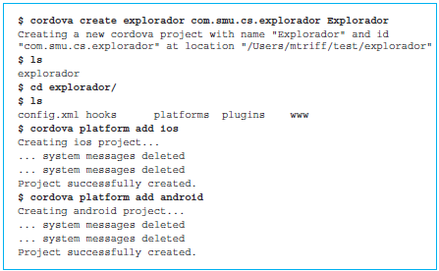
Setting up the Explorador app for Apple iOS and Android platforms
Launch the Terminal app on the Apple computer to get to the command line interface.
Command line session that begins the process of creating the native versions of the Explorador app for iOS and Android on an Apple computer.

Slide 5
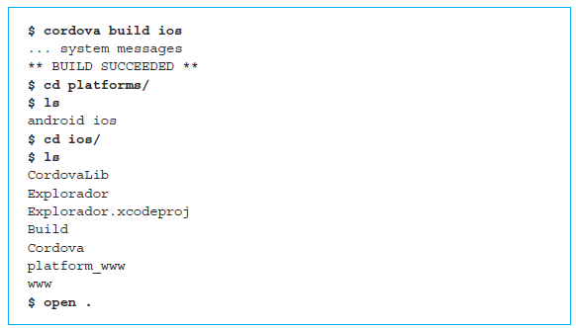
Building iOS app
Commands specific to building the iOS app are shown below.

Slide 6
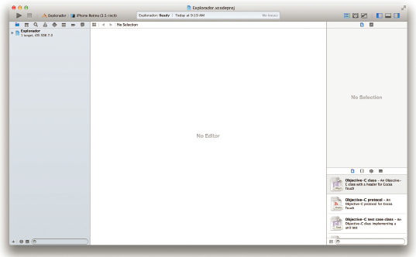
iOS project for the Explorador app opened in the Xcode IDE

Slide 7
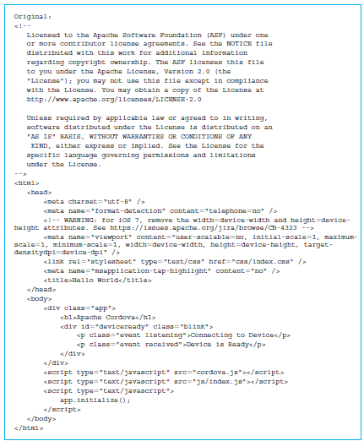
Automatically generated index.html file for the Explorador app
iOS build operation created an empty shell of an app that uses an automatically generated index.html file.

Slide 8
Modified index.html file
Set the title of the file to Explorador.
The cordova.js script from the automatically generated file is necessary for all Cordova apps to start and communicate with the device.
Add another JavaScript tag that adds an event listener using the method document.addEventListener() for the event “deviceready”.
When the app finishes loading and the device is ready to proceed, the event “deviceready” will be triggered by Cordova and the function launchExplorador() will be executed.
Rebuild the app

Slide 9
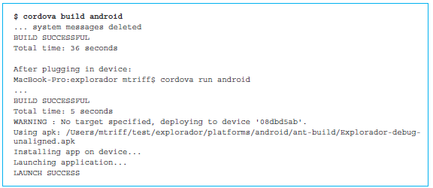
Building the Android app
Launched the iOS version through an iPhone emulator by using the Xcode IDE.
Connected an Android device, a Nexus 7 tablet, to launch the app on instead.

Slide 10
Quick facts/buzzwords
Apache Cordova: A platform for building native apps using HTML5/CSS3/JavaScript.
Java: Programming language used to build native Android apps.
Objective-C: Programming language used to build iOS apps.
IDE: Integrated development environment for building, compiling, and running programs.
Xcode: IDE used to develop iOS apps.
Visual Studio: IDE for building apps for Windows 8 tablets and phones.
C#: One of the languages that can be used to develop apps for Windows 8 tablets and phones.

